Slide 1
Mathematics Curriculum Framework of Singapore
SEAMEO-RECSAM and University of Tsubuka
Joint Seminar
15-18 Feb 2016
Notes:
About myself:
Deputy Director and Lead Specialist, Mathematics
From the Sciences Branch, Curriculum Planning and Development Division, Ministry of Education, Singapore
Oversee the development of the national mathematics curriculum from K-12

Slide 2
Section 1
Background

Slide 3
Background
The national mathematics curriculum comprises a set of documents (called syllabuses) covering the teaching, learning and assessment of mathematics from Grade 1 to 12. There is no separate standards document.

Slide 4
Background
There are 3 broad levels
Primary (Grade 1 to 6)
Secondary (Grade 7 to 10)
Pre-University (Grade 11 to 12)

Slide 5
Background
At each level, there are different syllabuses, reflecting the choices available in the system. For example, at the secondary levels, there are:
Express
Normal (Academic)
Normal (Technical)

Slide 6
Background
SOURCE: Ministry of Education, Singapore. (2015). Bringing out the best in every child: Education in Singapore. Design Branch, Communications. Retrieved on 11 Feb 2016 from http://www.moe.gov.sg/about/files/moe-corporate-brochure.pdf.
© Ministry of Education, Singapore

Slide 7
Background
The syllabuses are reviewed by MOE regularly. Past cycles have been 6 years.
The review involves consultations with key stakeholders and partners like teachers, academics, examiners, teacher-trainers.

Slide 8
Background
MOE supports schools in the implementation of the syllabuses. This support includes communication, professional development, approval of textbooks and the development of other supporting materials.

Slide 9
Background
Each revision is accompanied by a new set of textbooks. MOE invites commercial publishers to produce textbooks and submit them for review. Schools choose textbooks from an approved textbooks list. Most schools use textbooks.

Slide 10
Background
Textbook authors are selected by the publishers. They could be academics, teachers or former teachers. Generally, students pay for the textbooks, with financial assistance given to those who need help. MOE helps to manage the pricing as part of the review process.

Slide 11
Background
MOE monitors the implementation of the syllabuses through regular contacts with schools, e.g. annual head of department seminars, school visits, focused-group discussion and workshops, and through data available e.g. TIMSS and national examinations.

Slide 12
Background
Schools conduct both formative and summative assessments to support learning, inform teaching and make decision about progression. Typically, there is an year-end examination for every level from P2. Other modes of assessment beyond pen-and-paper tests are also used.

Slide 13
Background
The national examinations at the end of primary, secondary and pre-university are based on the national curriculum. MOE works closely with the Singapore Examinations and Assessment Board (SEAB) to design and develop the national examinations. This follows from every syllabus review.

Slide 14
Background
The strong alignment between the intended curriculum and the national examinations is key to strengthen the fidelity of implementation even as schools have the autonomy to customize and innovate.

Slide 15
Section 2
Format of National Curriculum
https://www.moe.gov.sg/education/syllabuses/sciences

Slide 16
Format of National Curriculum
The writing of the national curriculum is largely influenced by the need to communicate the thinking behind the curriculum arising from the review and guided by practical considerations to support teachers so that they can do a good job.

Slide 17
Format of National Curriculum
The syllabuses have common sections giving an overview of the entire mathematics curriculum, the goals and aims of each syllabus to give teachers to big picture of the curriculum. (p.7)

Slide 18
Format of National Curriculum
The spiral design is used to build the content up from one level to another. Such an approach also allows for connections to be made across strands.

Slide 19
Format of National Curriculum
The mathematics curriculum framework is explained in every syllabus to promote a shared understanding of central focus of mathematics education (i.e. problem solving) and the components and broad description of the approaches

Slide 20
Format of National Curriculum
Each syllabus details the content to be taught and learned (year-by-year, except from grade 9 onwards) and the learning experiences that teachers should create for the target group of students offering the syllabus.

Slide 21
Format of National Curriculum
The inclusion of statements of learning experiences and a process strand is new and is intended to influence the way teachers teach and students learn and to give attention to the development of mathematical processes.

Slide 22
Format of National Curriculum
General guidance on teaching, learning and assessment is given in the documents. This includes the principles of teaching and learning, the phases of learning, role and practice of assessment.

Slide 23
Format of National Curriculum
The current version evolves and builds on from previous version. This is an important point, because teachers have tacit understanding and assumptions about the scope based on the description of the content.

Slide 24
Format of National Curriculum
Levels | Content Strands
A-level Math (Optional) | Functions, Graphs, Sequences and Series, Vectors and Complex Numbers |  | Statistics and Probability | Calculus
Secondary (Add Math) (Optional) | Algebra | Geometry and Trigonometry | X | Calculus
Secondary | Number and Algebra | Measurement and Geometry | Statistics and Probability | x
Primary | Number and Algebra | Measurement and Geometry | Statistics | x

Slide 25
Format of National Curriculum
The development of content follows a spiral approach, facilitating connections and inter-relationships. An example is the use of algebra in measurement problems. Each strand is revisited and taught with increasing depth.

Slide 26
Format of National Curriculum
The process strand highlights the important mathematical processes that students should develop in the course of learning. Of particular emphasis is mathematical modelling.

Slide 27
Format of National Curriculum
A Walk Through
Secondary Math Syllabus

Slide 28
Section 3
Direction of Reforms

Slide 29
Challenges
Two big questions in every review
Staying relevant
Improving learning

Slide 30
Direction of Reforms
We need to support those who need more help to learn mathematics
We need to go beyond knowing to being able to apply mathematics meaningfully
We need to support the development of other important 21st century competencies

Slide 31
Section 4
Recommendations

Slide 32
Recommendations
To engage different learners
To focus on how students learn
To develop the capacity to learn on their own

Slide 33
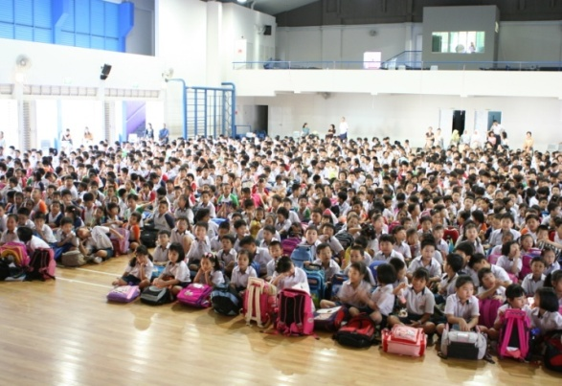
Key Facts and Figures
Half a million students
32,000 teachers
356 schools
173 Primary
155 Secondary
and others
Notes:
As you can see from this slide, our budget for education this year is S$9.7 billion, or nearly $7.5 billion USD. This constitutes 3.6% of our GDP
We have some 360 schools, most of which are Primary & Secondary Schools. These cater to some half a million students.
As for the Post-Secondary Education Institutions, which include our Junior Colleges, Polytechnics, Institute of Technical Education and Autonomous Universities, they have about 150,000 students in total.
--------------------------
Info: Mixed Level schools include full schools (pri + sec), Upper Sec + JC schools, Sec 1-JC schools
506,609 students, 29,740 teachers, 1,689 AEDs, 5,613 EAS [correct as of end Jun 2010]
355 schools – 173 Primary, 154 Secondary, 15 Mixed Level, 13 Junior Colleges/ Centralised Institute [correct as of end Sep 2010]
PSEIs - 152,551 students, 11,086 teaching staff, 13,451 non-teaching staff [correct as of Sep 2009]
Updated figures for ITE in 2010 are 1634 academic staff, 809 non-academic staff and student enrolment 24,715
Updated figures for polytechnics in 2010 are 5,086 academic staff, 2,797 non-academic staff and student enrolment 76,712

Slide 34
Primary
English
Mother Tongue
Mathematics
Science (from P3)
Arts
Music
Civic and Moral Education
Social Studies
Physical Education
Co-curricular activities
English, Mother Tongue, Mathematics and Science offered at Standard or Foundation level from P5
Literacy and numeracy
Common curriculum to P4
Subject-based banding at P5
Primary School Leaving Examination

Slide 35
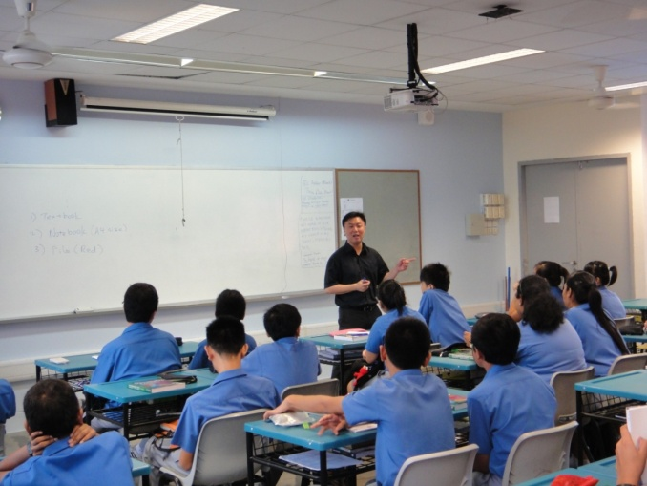
Secondary
English
Mother Tongue
Mathematics
Science
Visual Arts
Music
Civic and Moral Education
History, Geography, Literature
Home Economics, Design & Tech
Physical Education
Co-curricular activities
Upper Sec Electives
All students continue to study English, Mother Tongue, Mathematics, at least one science and one humanities subject
Express (4 years to O-level)
Normal(Academic) (4 years to N(A) level; +1 year to O-level)
Normal(Technical) (4 years to N(T) level)
Flexibility & transfers

Slide 36
Pre-University
Knowledge Skills & Life Skills
General Paper
Project Work
Co-curricular Activities
Civics
Physical Education
Languages
Mother Tongue, Third Language
Mathematics & Sciences
Mathematics, Physics, Chemistry & Biology, Computing
Arts and Humanities
Arts, Economics, Geography, History, Literature, Music
Academic subjects offered at H1, H2 and H3 levels
Contrasting subject requirement
2-3 years to A-level

Slide 37
Others
Integrated Programme Schools
Started in 2004
NUS High School of Mathematics and Science
Set up in 2005
School of the Arts
Set up in 2007
School of Science and Technology
Set up in 2010
Integrated Programmes
6 years direct to A-level or IB
Enriched programme
Specialised Independent Schools
Niche programme
Customised programme

Slide 38
Importance of Mathematics
Compulsory up to the end of Secondary education
Centrally planned, flexible implementation
Options and electives at higher grades
Curriculum 
Levels | Per Week | %
Primary | 3 to 5.5 h | 15-27%
Secondary | 2 to 4 h | 12.5-25%
Pre-University | 2 to 6 h | 6.4-12%
Depends on electives and levels

Slide 39
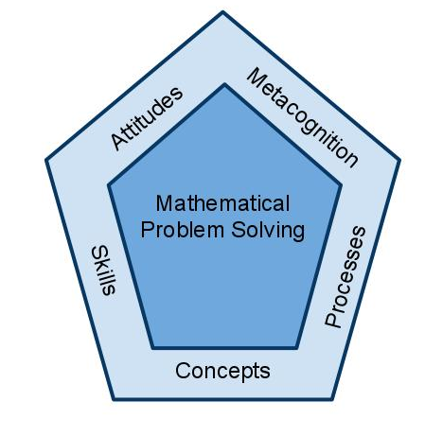
Mathematics Curriculum Framework
Beliefs
Interest
Appreciation
Confidence
Perseverance
Monitoring of one’s own thinking
Self-regulation of learning
Numerical calculation
Algebraic manipulation
Spatial visualisation
Data analysis
Measurement
Use of mathematical tools
Estimation
Reasoning, communication and connections
Applications and modelling
Thinking skills and heuristics
Numerical, Algebraic
Geometric, Statistical
Probabilistic
Analytical
Notes:
The Singapore mathematics curriculum framework sets the direction for the teaching and learning of mathematics – it shows the underlying principles of the mathematics program that is applicable to all levels (from the Primary Level to the Advanced Level).
The central focus of our mathematics curriculum is problem solving. There are 5 inter-related components that support the attainment of the mathematical problem solving.
Students need to acquire a wide range of mathematical concepts and skills, achieving understanding and proficiency in these areas. They have to develop competency in generic processes, such as communication, making connections, heuristics and thinking skills. Beyond that, a good problem solver should develop metacognitive skills. The affective domain of cultivating a positive attitude towards mathematics will foster interest and perseverance in learning and doing mathem

Slide 40
General Aims of Mathematics Education
Acquire and apply mathematical concepts and skills;
Develop cognitive and metacognitive skills through a mathematical approach to problem solving; and
Develop positive attitudes towards mathematics

Slide 41
Primary mathematics
Laying a Strong Foundation

Slide 42
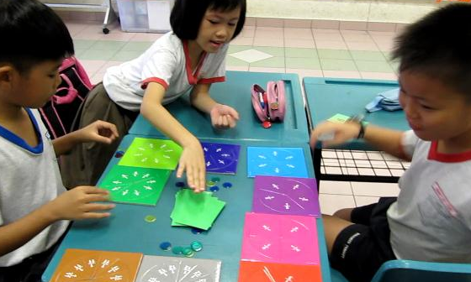
Aims
Acquire mathematical concepts and skills for everyday use and continuous learning in mathematics;
Develop thinking, reasoning, communication, application and metacognitive skills through a mathematical approach to problem-solving;
Build confidence and foster interest in mathematics

Slide 43
Primary
Three strands
Number and algebra
Measurement and geometry
Statistics
Word problems
Algebra without symbol
Whole numbers
Fractions
Decimals
Four operations
Rate, Ratio, Proportion
Time
Money
Length, Area, Volume and Mass
Basic shapes and properties
Direction
Symmetry
Spatial visualisation
Reading from picture graphs, bar graphs, line graphs, pie charts

Slide 44
Differentiation at Upper Primary
Primary 5 & 6 Standard Mathematics Percentage, Ratio and Speed Area and Volume Data and graph Geometry Algebra | Primary 5 & 6 Foundation Mathematics Re-visit some of Primary 1–4 content Percentage Area and Volume Data and graph Geometry
Primary 1–4 Number concepts and operations Measurements (length, mass, time, angle, area, volume etc.) Basic shapes Data and graphs

Slide 45
Secondary mathematics
Building up strengths

Slide 46
Different Syllabuses
3 syllabuses
O-Level
N(A)-Level
N(T)-Level
N(A) ⊂ O
N(T) ⊂ N(A)
Electives at upper secondary

Slide 47
Aims
O and N(A) Math
N(T) Math
Acquire mathematical concepts and skills for continuous learning in mathematics and to support learning in other subjects;
Develop thinking, reasoning, communication, application and metacognitive skills through a mathematical approach to problem solving;
Connect ideas within mathematics and between mathematics and other subjects through applications of mathematics; and
Build confidence and foster interest in mathematics.
For students who are bound for post-secondary vocational education to:
Acquire mathematical concepts and skills for real life, to support learning in other subjects, and to prepare for vocational education;
Develop thinking, reasoning, communication, application and metacognitive skills through a mathematical approach to problem solving; and
Build confidence in using mathematics and appreciate its value in making informed decisions in real life.

Slide 48
O and N(A) Math
Numbers and their operations
Ratio and proportion
Percentage, Rate and speed
Algebraic expressions and formulae
Functions and graphs
Equations and inequalities
Set language and notation
Matrices
Angles, triangles and polygons
Congruence and similarity
Properties of circles
Pythagoras’ theorem and trigonometry
Mensuration
Coordinate geometry
Vectors in two dimensions
Data Analysis
Three Strands
Numbers and Algebra
Measurement and Geometry
Statistics and Probability
Problems in real-world contexts

Slide 49
N(T) Math
Numbers and their operations
Ratio and proportion
Percentage, Rate and speed
Algebraic expressions and formulae
Functions and graphs
Solutions of equations
Angles, triangles and polygons
Symmetry, congruence and similarity
Pythagoras’ theorem and trigonometry
Mensuration
Data Analysis
Probability
Problems derived from real-world contexts
Three Strands
Numbers and Algebra
Measurement and Geometry
Statistics and Probability
Real-world contexts
Geared towards vocational training

Slide 50
Elective for Math
O & N(A) Additional Math
For students who have an aptitude and interest in mathematics to:
Acquire mathematical concepts and skills for higher studies in mathematics and to support learning in the other subjects, in particular, the sciences;
Develop thinking, reasoning and metacognitive skills through a mathematical approach to problem solving;
Connect ideas within mathematics and between mathematics and the sciences through applications of mathematics; and
Appreciate the abstract nature and power of mathematics

Slide 51
O and N(A) Add Math
Algebra
Equations and inequalities
Indices and surds
Polynomials and Partial Fractions
Binomial expansions
Power, Exponential, Logarithmic Modulus Functions
Geometry & Trigonometry
Trigonometric functions, identities and equations
Coordinate geometry in two dimensions
Proofs in plane geometry
Calculus
Differentiation and integration
Upper secondary elective
Extension of algebra and trigonometry
Introduction of calculus
Valued by pre-university and polytechnics

Slide 52
Pre-university Mathematics
Gearing for University Education

Slide 53
Aims
H2 for Math, Science & Engineering
H1 for Business & Social Sciences
H3 for those with passion and aptitude for Math

Slide 54
A-level Math
H1 and H2
Functions and graphs
Sequence and Series
Differentiation and Integration
Inferential Statistics – hypothesis testing, correlation
Probability
Combinatorics
H3
MOE-Combinatorics, Differential Equations, Functions and Graphs
NUS-Linear Algebra
NTU-Numbers and Matrices
H1 – 2h per week
H2 – 4h per week
H3 can be taken with H2
Common element of H3
Proof, modelling & applications
Graphing calculators
High participation

Slide 55
Review of math curriculum
2013 Mathematics Curriculum, Thinking Behind

Slide 56
2013 Curriculum
Part of scheduled review
Improve teaching and learning
Support the development of 21st Century Competencies
Other curriculum-wide initiatives
Centrally driven
Extensive consultation
One steering committee
Six working committees
> Primary
> O and N(A)
> N(T)
> O and N(A) Additional Math
> H1 and H2
> H3
Six Consultative groups
Engaging teachers in pre- and post-draft discussion
Environmental scan
TIMSS Findings
Examination and impact on learning

Slide 57
2013 Curriculum
Learning to learn
21st century skills
Real understanding, not just examination preparation
More opportunities for students to reason, communicate, make connections and apply
Experience mathematical modelling
Be a critical and creative user of mathematics
Explicit listing of learning experiences ‘Students should have the opportunities to ...’
Strengthen mathematical processes
Learning outcomes and experiences
Little change in content
Influence teaching and learning

Slide 58
Textbooks and Resources
Tap on creativity of publishing industry
Quality and variety
Textbook authorisation process
> Invitation to publish
> Briefing to publishers
> Feedback on conceptual framework
> Forming review panel
> Provisional approval or rejection
> Final approval
> Listing of textbooks
Whole process takes about 12 months for each level submission
Textbooks influence teaching and learning
Best form of support for teachers
Align with curriculum changes
Other resources from MOE

Slide 59
National Examinations
High stake examinations at P6, S4/5 and Pre-U
Examinations influence practices
Close consultations with examinations authority
Specimen papers
PSLE by Singapore Examinations and Assessment Board (SEAB)
O, N(A), N(T) and A-levels by SEAB and Cambridge International Examinations (CIE)
SEAB part of review committee
Joint development of specimen paper
Approximate 12 months to complete

Slide 60
Thank You
Notes:
Go ma sseum ni da

